Slide 1

Used Cars Price Analysis

Slide 2

About Us
Name : A . Prathyusha
Qualification : BSC(Biotechnology)
Work Experience : Fresher
Name : T .Nithin
Qualification : BSC(MPCS)
Work Experience : Fresher
We want to learn data science for skills and career transformation. It has great job opportunities

Slide 3
Contents
Introduction
Problem statement
Scraping
Data Collection
Libraries used
Interface of Web site
Raw Data and Cleaned Data
Data Cleaning
Data Visualization
Conclusion
Challenges

Slide 4
INTRODUCTION
Carwale is an online platform that provides information related to cars.
It is also provide services such as car financing, insurance and car maintenance .
The platform is designed to help car buyers make informed decisions about which car to buy based on their needs and preferences.

Slide 5
PROBLEM STATEMENT
Car price variation based on various cars brands.
Best cars with good quality with less price.

Slide 6
WEB SCRAPING
Web scraping is an automatic method to collect large amounts of data from websites.
Web Scrapping extracts the data from websites in the unstructured format.
Beautiful Soup is used extract information from the HTML format and XML files.

Slide 7
DATA COLLECTION
CarWale website has the information related to used Car.
"https://www.carwale.com/used/cars-for-sale/#sc=-1&so=-1&car=7+16+8+10&city=105&pc=105&pn"
We used Beautiful Soup, Requests together the data from the website

Slide 8

TOOLS USED
Web Scraping Tools
Python
Google chrome
Beautiful Soup
Requests

Slide 9





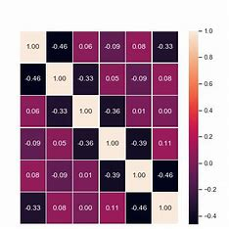
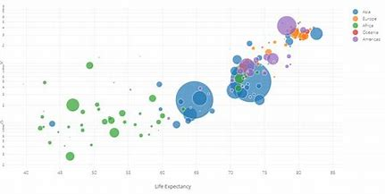
.
2. DATA CLEANING AND MANUPULATING
Numpy
Pandas
Regular Expression
3. DATA VISUALIZATION
Matplotlib
Seaborn

Slide 10
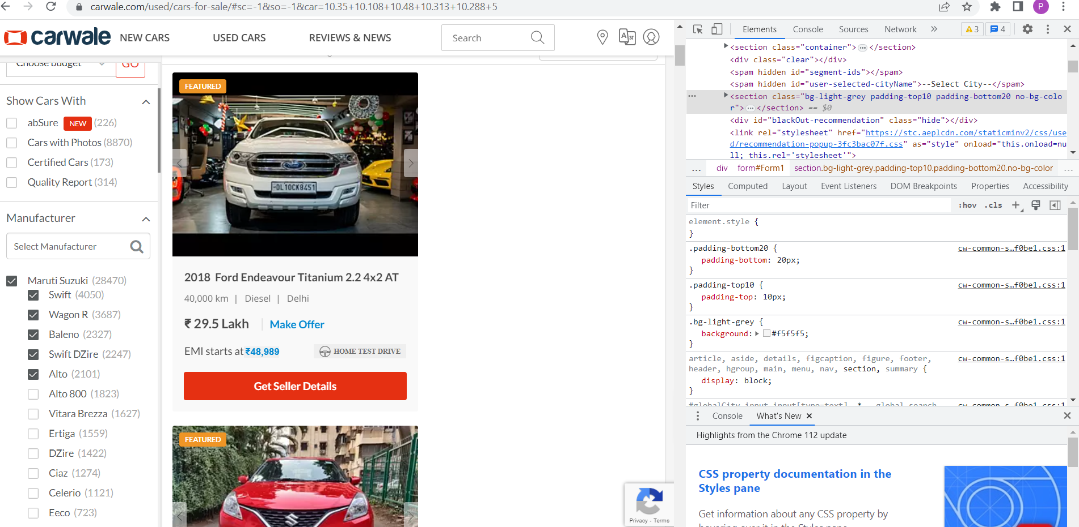
INTERFACE OF THE WEBSITE ALONG WITH HTML

Slide 11
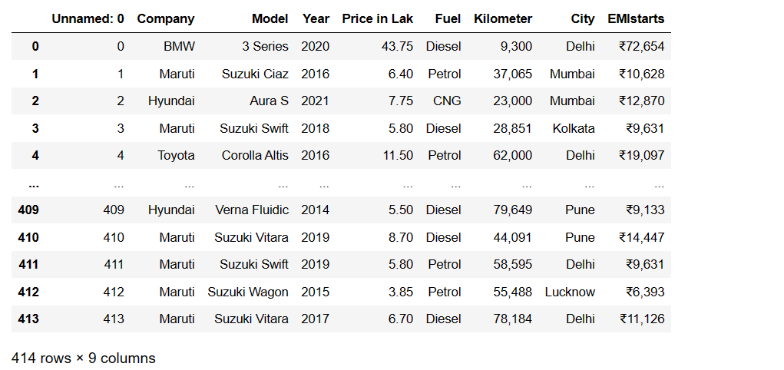
RAW DATA COLLECTION FROM CARWALE :

Slide 12
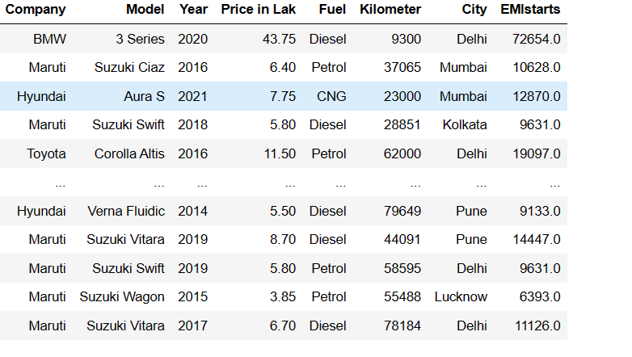
CLEANED DATA

Slide 13
DATA CLEANING
Check for Duplicates
Drop the duplicate column and unnecessary columns.
Checking and removing special characters.
Identifying missing values.
Data Type conversion.

Slide 14
DATA VISUALIZATION
UNIVARIATE ANYLYSIS:
Univariate data consists of only one variable.
The analysis of univariate data is thus the simplest form of analysis since the information deals with only one quantity that changes.
1. Categorical
2. Numerical
BIVARIATE ANALYSIS:
Bivariate data involves two different variables.
The analysis of this type of data deals with causes and relationships and the analysis is done to find out the relationship among the two variables.
1. Categorical and Categorical
2.Categorical and Numerical
3.Numerical and Numerical

Slide 15
MULTIVARIATE ANALYSIS:
Multivariate analysis is required when more than two features have to be analyzed simultaneously.

Slide 16
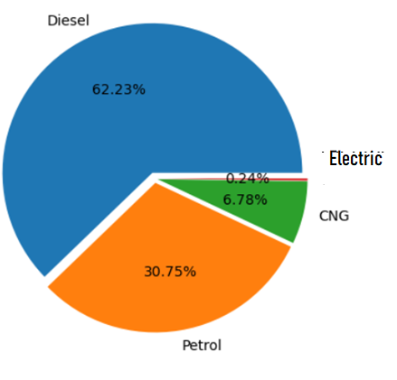
ANALYSIS ON FUEL IN PERCENTAGE :
Insights: Diesel fuel is using highly compared to all another fuels like Petrol, CNG, Electric.
Electric Fuel and CNG Fuel is using less in
number compared to another fuels .

Slide 17
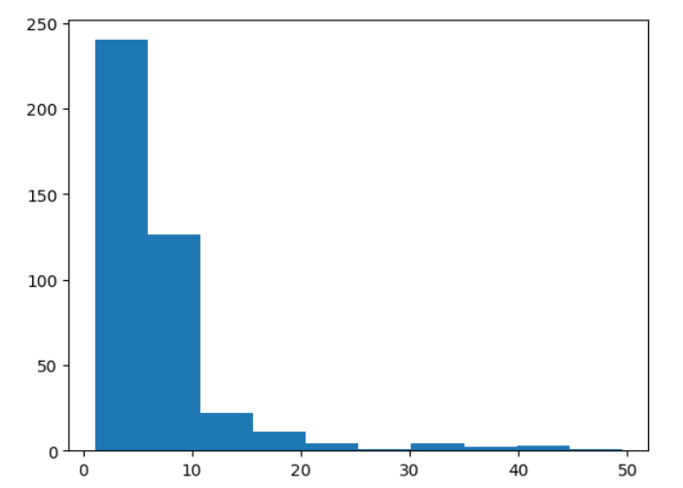
ANALYSIS ON PRICE IN LAKHS:
Insights: The range between 1- 10 lakhs has more sales and distribution upto 50 lakhs.

Slide 18
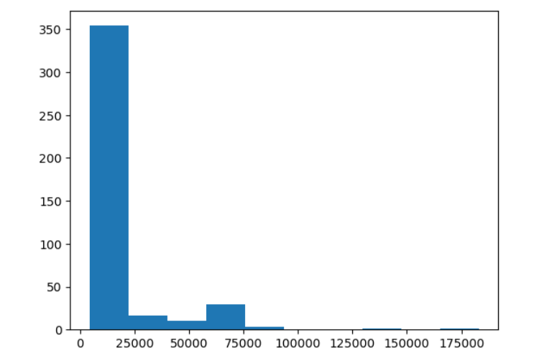
ANALYSIS ON EMI :
Insights: The range of EMI paid between 1000-25000 is high and distribution upto 175000

Slide 19
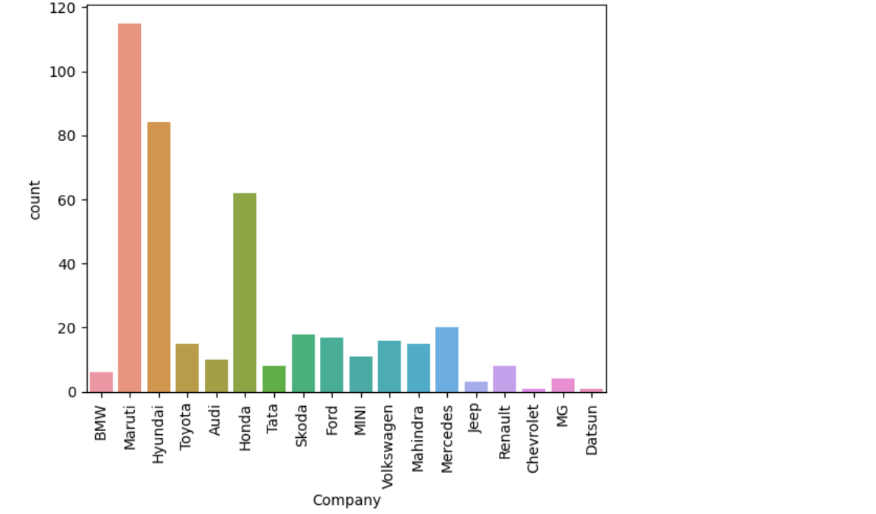
ANALYSIS ON COMPANIES COUNTS:
Insights : Maruti cars are sales more in number comparing to all other company cars.
Datsun Company cars are sales in less number.
By analyzing the graph we can conclude that Maruti cars are leading in market.

Slide 20
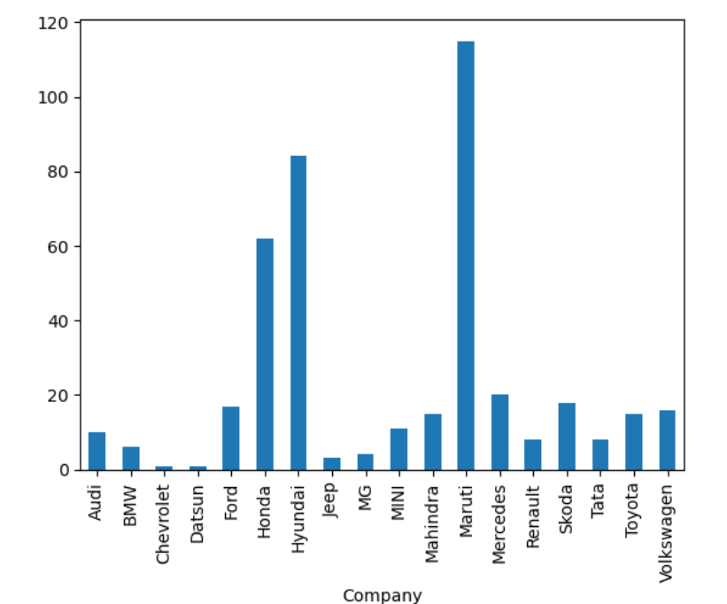
ANALYSIS ON NUMBER OF CARS IN A COMPANY
Insights : Maruti has the highest number of cars and Datsun has lowest number of cars.

Slide 21
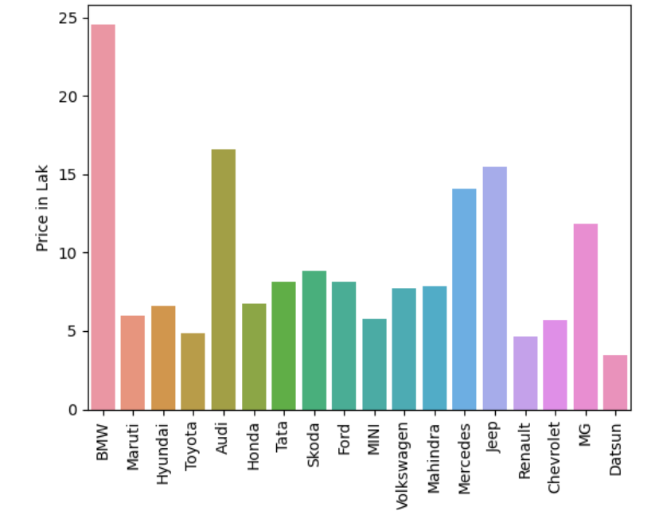
ANALYSIS ON COMPANY VS PRICE IN LAKHS
Insights : BMW car has high price compared to all other cars.
Datsun car has less price compared to all other cars.

Slide 22
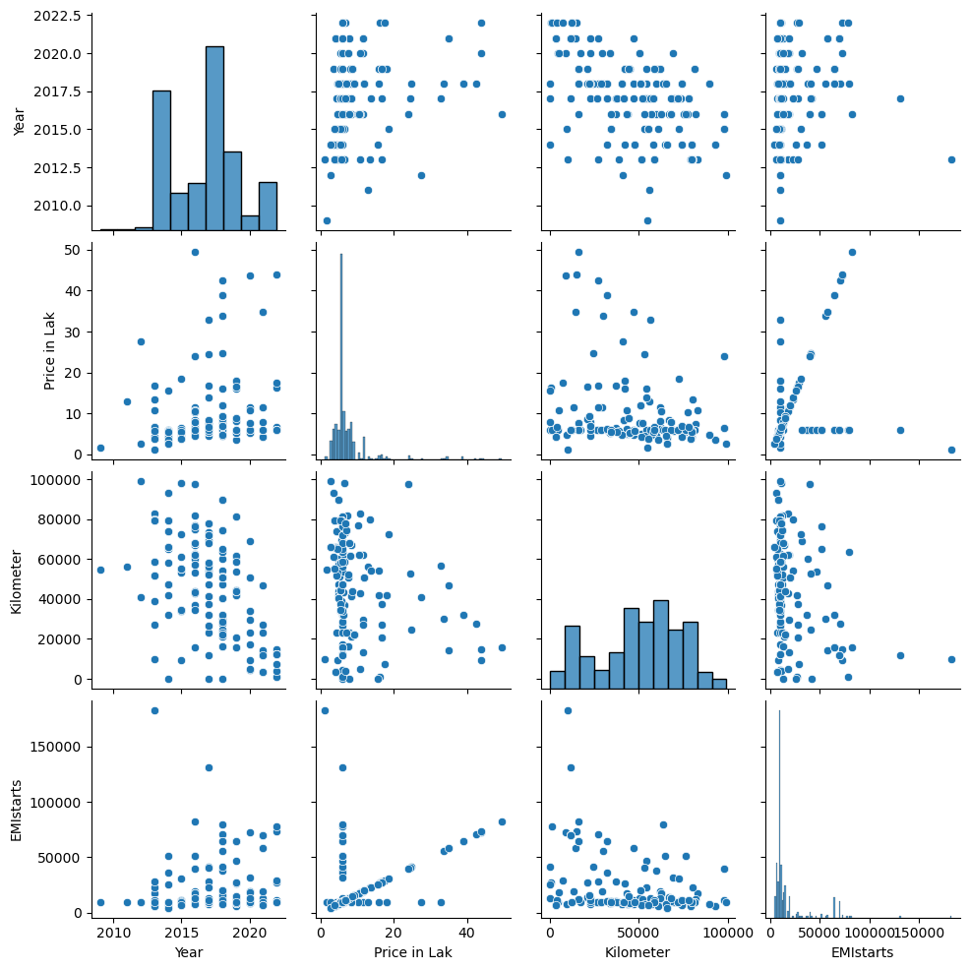
ANALYSIS ON NUMERICAL COLUMNS
Insights : Price in lakhs is increased EMI is increased .
Year is increased price is increased

Slide 23
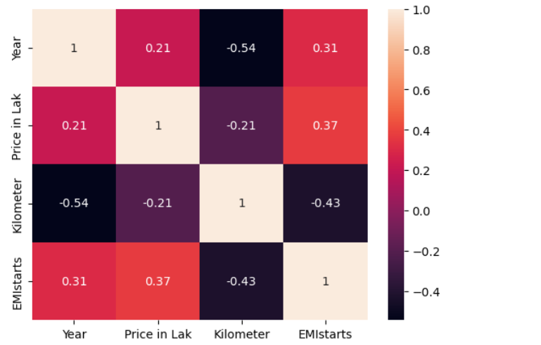
ANALYSIS ON CO-RELATION
Insights : EMI starts and price in lakhs has positive co -relation.
kilometer and year has negative co-relation.

Slide 24
CONCLUSION
we conclude that Datsun car is having low budget compare to all other company cars.
According to fuels Diesel is used more compared to all other fuels.
Maruti cars is leading in market.

Slide 25
CHALLENGES
When we run url the length of Data Frame will be changed .
When we cleaning the data we face some difficulties like removing rupee symbol.
While using this Website we get response 403 so we headers to over come this problem.
We Face some problems to fill nan values .

Slide 26
Thank you

